Slide 1
Five Senses in Life Of Pi by Yann Martel
By: Jake haas

Slide 2
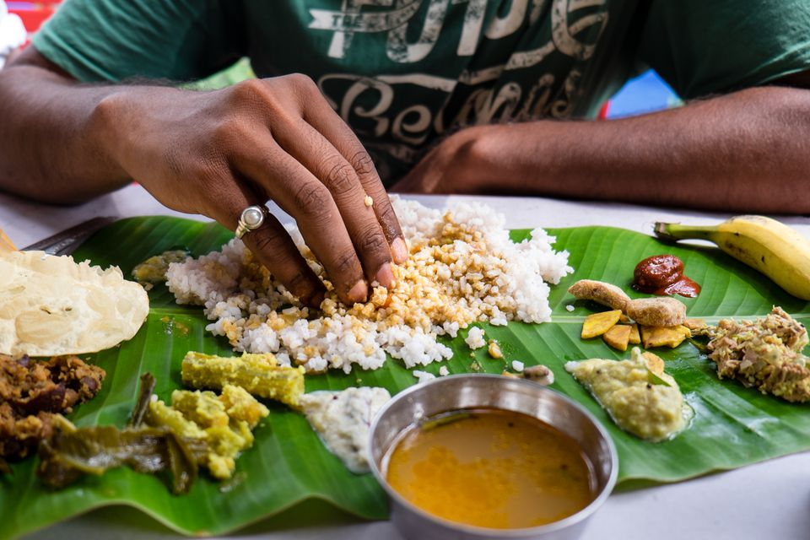
The Sense of Taste
The first time I went to an Indian restaurant in Canada I used my fingers. The waiter looked at me critically and said, “Fresh off the boat, are you?” I blanched. My fingers, which a second before had been taste buds savouring the food a little ahead of my mouth, became dirty under his gaze. They froze like criminals caught in the act. I didn’t dare lick them. I wiped them guiltily on my napkin. He had no idea how deeply those words wounded me. They were like nails being driven into my flesh. I picked up the knife and fork. I had hardly ever used such instruments. My hands trembled. My sambar lost its taste.
-Pg 7
Eating food with your bare hands is commonplace in many parts of India. In the Ayurvedic teachings it was taught that each finger is representative of a different element, space, air, water, fire, and earth. The hands are used to test the temperature of the food you are eating and creates a spiritual connection to it. It is considered impolite to get your palms or back of your fingers dirty however, and only the fingertips are used.

Slide 3
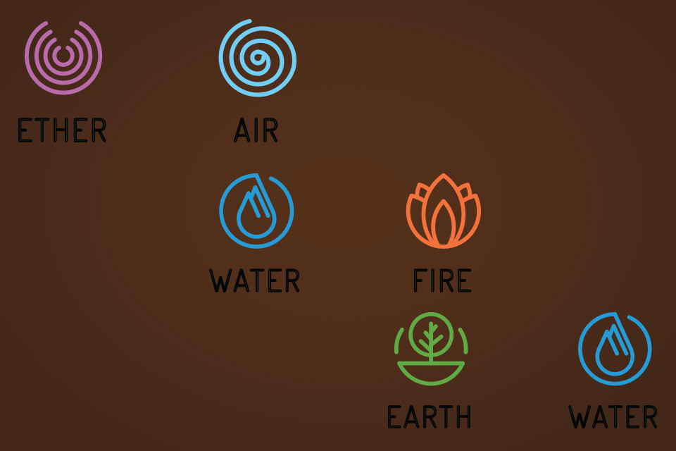
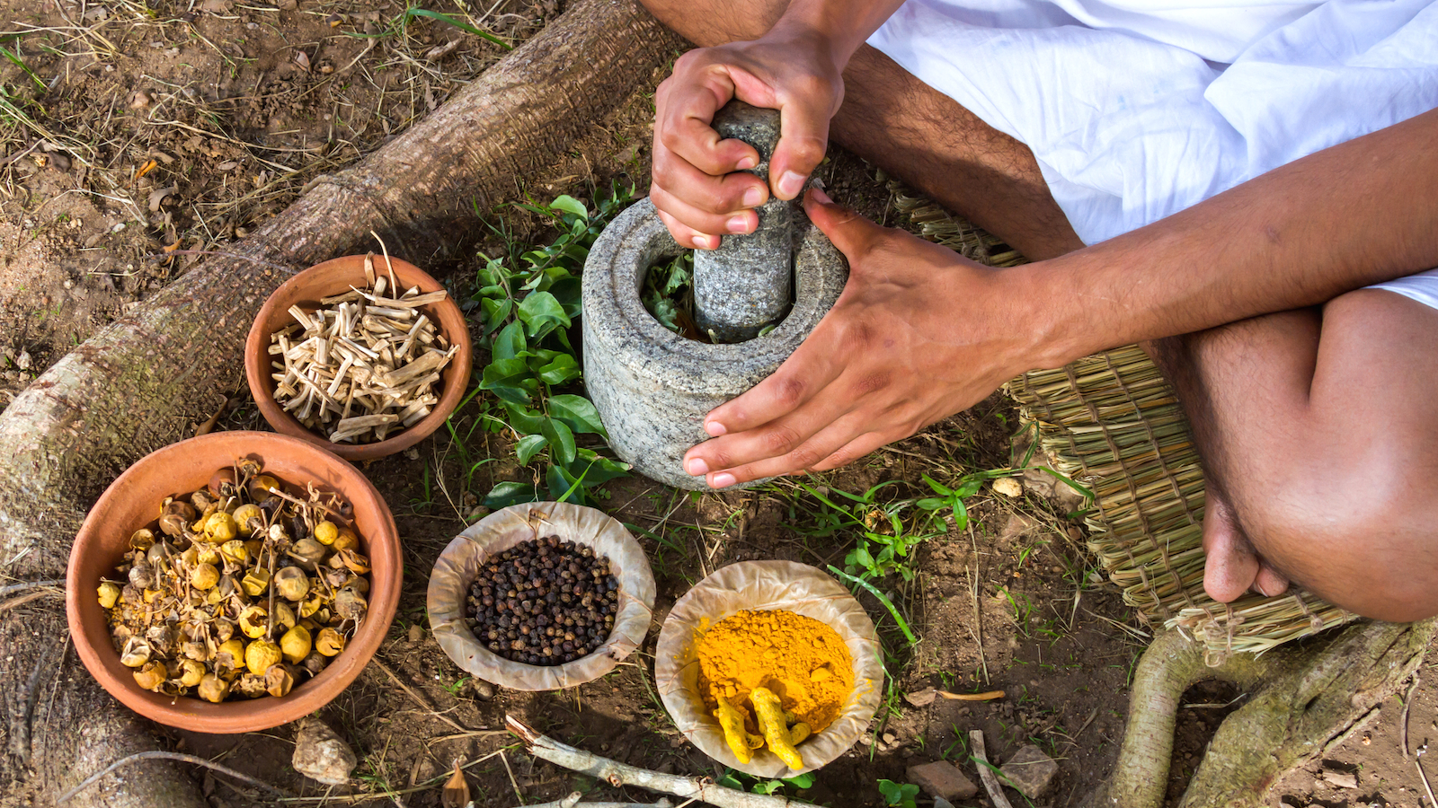
The Ayurvedic Teachings
Ayurveda is a traditional system of medicine originating in the Vedic culture of India that has been used for thousands of years. It provides insight into the ideal daily and seasonal routines to help a person reach their full human potential. It teaches that health is a balance between body and spirit.
According to the Ayurvedic Teachings humans are a part of nature and are composed of three energies, air, fire, and earth. When these are out of balance a person experiences mental or physical health problems such as insomnia, or weight gain.
Ayurveda also teaches that eating food with your hands keeps you connected and balanced with all the elements and has health benefits.

Slide 4
Cultural Significance
How The Ayurvedic Teachings Illuminate Indian Culture
The ayurvedic teachings illuminate indian culture by showcasing a strong connection to indian history, and showing the importance that indians places on past beliefs and traditions. Even though ayurveda was practiced thousands of years ago it is still an important part of indian tradition and culture.
How This Passage is Connected
The passage that I chose from the life of Pi connects strongly to this secondary source because when Pi follows the ayurvedic practice of eating using your hands his canadian waiter says that he is “fresh off the boat”. When the waiter says this Pi is hurt badly and feels ashamed, showing how strongly the indian practice is tied into his culture, and showing how alienated he feels not being able to follow it in Canada.
Significance in this Portfolio
This source was important to include in this cultural portfolio because it shows the importance of history and tradition in indian culture. The ayurvedic teachings are widespread across india and have deep ties to its culture.

Slide 5
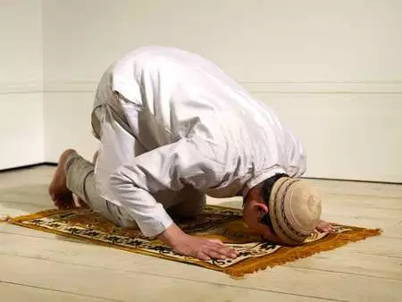
The Sense of Hearing
We prayed together and we practiced dhikr, the recitation of the ninety-nine revealed names of God. He was a hafiz, one who knows the Qur’an by heart, and he sang it in a slow, simple chant. My Arabic was never any good, but I loved its sound. The guttural eruptions and tiful brook. I gazed into this book for long spells of time. It was not wide, just one man’s voice, but it was as deep as the universe.
-pg 62
Muslims have 5 mandatory prayer times a day which set the rhythm of their day and help them feel more connected to all of the people in the world. They do not pray for the benefit of their God Allah but for themselves because Allah has no needs.

Slide 6
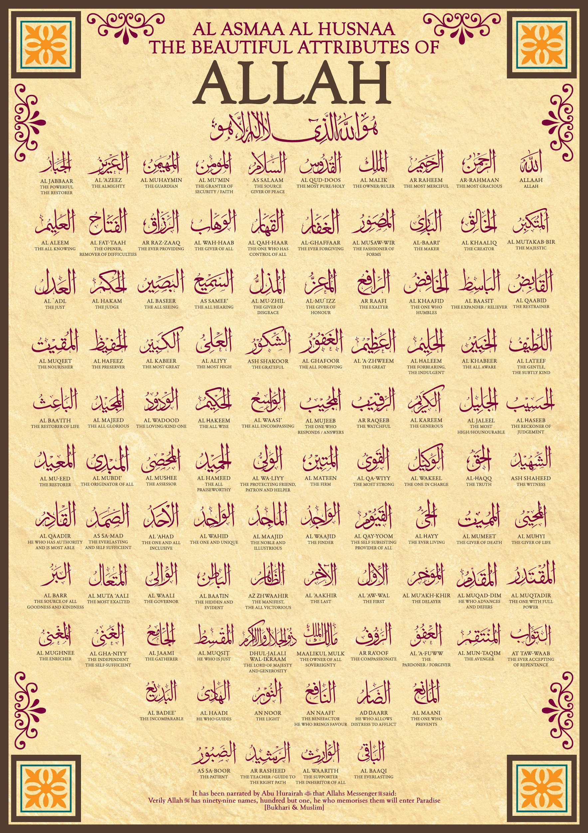
The Ninety-Nine Revealed Names of Allah
In Islam Allah has ninety-nine which are revealed in the Quran. These names describe Allah’s attributes and any muslim who memorizes them all will gain entrance into Jannah. Some of Allah’s names as described in the Quran are:
Ar-Rahmân - The beneficent - he who wills goodness and mercy for all creatures
As-Salam - The embodiment of peace - The one who is free from every imperfection
Dhikr is the muslim practice of reciting the revealed names of Allah, doing this periodically is the greatest deed a muslim can do in the eyes of Allah. A dhakir is someone who continuously performs dhikr and is a very honourable title to hold. It is believed that for every utterance of dhikr a tree is planted for you in Jannah.

Slide 7
Cultural Significance
How Allah’s Ninety-nine Names Illuminate Indian Culture
Allah’s ninety-nine names help illuminate Indian culture because Islam is a common religion in India which has a variety of traditions that shape the way people think, being a Dhakir gives a muslim a high social standing and they are looked up to by many people.
How This Passage is Connected
The passage that I chose from Life of Pi is connected to the ninety-nine names of Allah because it describes Pi and Mr. Kumar practicing dhikr, the recitation of Allah’s names. Mr. Kumar is a hafiz, a person who has memorized the Quran by heart, and similarly to a dhakir has a high social standing among other Islamic believers.
Significance in this Portfolio
This source was important to include in this portfolio because it explains an important aspect of Islam, and contributes to the overall understanding of Indian culture. In India it is common for a person to speak one of Allah’s ninety-nine names when they pray, eat, sleep, and experience the world around them as a toast to Allah’s creations, something that is not very common in Canadian culture.

Slide 8

The Sense of Smell
The bottom of the oven was covered with smooth pebbles. He was explaining to me how the bread was baked on these heated pebbles when the nasal call of the muezzin wafted through the air from the mosque. I knew it was the call to prayer, but I didn’t know what it entailed.
-pg 59
Halal is often served in mosques during times of prayer. Halal usually refers to food that God permits to be eaten, and is often represented by bread.

Slide 9
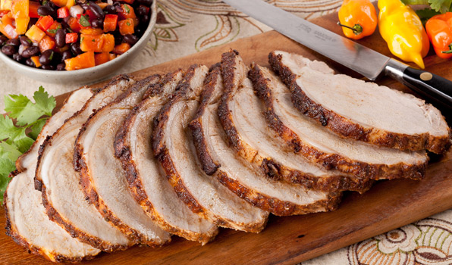
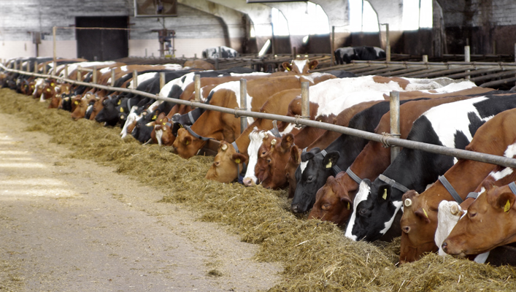
Indian Cuisine
In Islamic law there are two main classifications of items which usually refer to food; halal and haram. Halal are items which are permitted by Allah and are allowed to be used by muslims. Harem are items which are not permitted by Allah and are not allowed to be used by muslims.
It is a common misconception that Muslims don’t eat meat. Though many muslims choose to be vegetarian the only meat considered to be harem by Allah is pork. The reason many modern muslims choose to be vegetarian is because muslims believe animals should be treated properly and be blessed before they are butchered. Many animal farms running today are seen as inhumane and blessings are rarely performed. Some farms market their meat specifically for muslim customers and have their animals treated well and blessed before they are killed.
Similarly, in Hinduism it is forbidden by God to eat beef, and because a large portion of the indian population is hindu and muslim there are very few indian dishes including beef or pork.

Slide 10
Cultural Significance
How Indian Cuisine Illuminate Indian Culture
Indian Cuisine illuminates Indian culture in many ways. Indians have a high degree of respect for animals and often choose not to consume meat because of their ethical and religious values. Food is a big part of any culture and because of the abundance of spices, and lack of beef or pork indian dishes are often immediately recognizable.
How This Passage is Connected
The passage that I chose from Life of Pi is connected to Indian cuisine because Mr. Kumar is explaining to Pi how he cooks the halal which is server in the muslim mosque. Halal is a staple in Indian dishes because a large portion of the population is muslim and businesses must serve food that conforms to the spiritual needs of everybody.
Significance in this Portfolio
This source was important to include in this portfolio because food is an essential part of every culture and is shaped by history, traditions and beliefs passed on from many generations. Indian food is unique because of historical events such as the first Mughal ruler, Babur preserving food from south India using spices, and also spiritual beliefs such as the Hindu beliefs about eating beef. This creates a strong cultural connection.

Slide 11
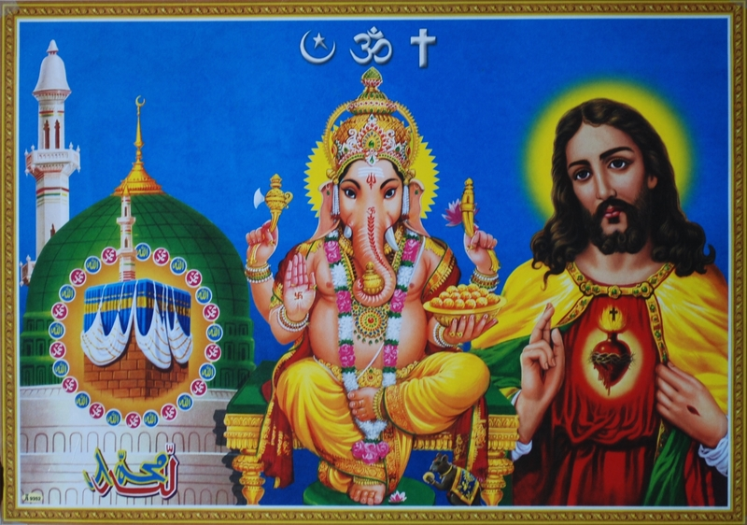
The Sense of Vision
A lifetime of peaceful vegetarianism stood between me and the willful beheading of a fish. I covered the fish’s head with a blanket and turned the hatchet around. Again my hand waived in the air. The idea of beating a soft, living head with a hammer was simply too much.
It is common in Indian culture for people to be vegetarian. In Islam Allah expressly prohibits pork to be eaten, and some muslims choose to be fully vegetarian because of this. Likewise in Hinduism it is believed that being vegetarian reduces your harm to other creatures.

Slide 12
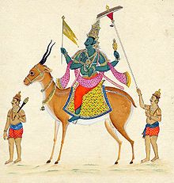
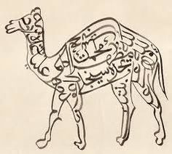
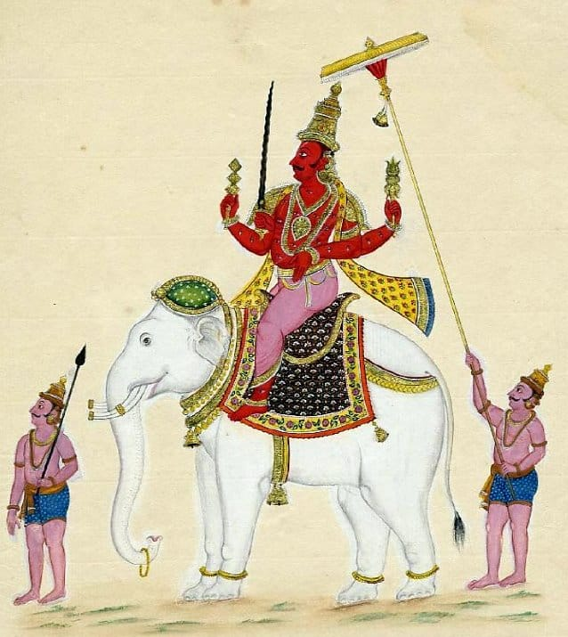
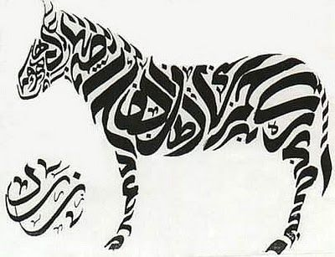
Treatment of Animals
In India animals are treated with a high degree of respect. In both hindu and islamic traditions it is a sin to mistreat animals, every living creature is believed to have a soul and intelligence. In both religions animals are described as being submissive to god, and in hinduism they are often depicted as chariots to the gods. In muslim beliefs animals have no free will but are lead by god-given instincts. This is a reflection of how muslims aim to submit to god.

Slide 13
Cultural Significance
How The Treatment Of Animals Illuminates Indian Culture
The way Indians treat animals is an important aspect of Indian culture. In India animals are treated with great respect because of the various beliefs that Indians share. In Hindu tradition it is a great sin to consume beef, and minimizing harm to animals is an important aspect of being hindu.
How This Passage is Connected
The passage I chose from Life of Pi is connected to the treatment of animals because Pi is struggling with killing a fish to eat it. This ties into his cultural beliefs because he is a practicing Muslim and Hindu, he has chosen to become a vegetarian to reduce his harm to animals . When he is put in this situation it becomes very clear how strong his beliefs are, most people would kill the fish without a second thought thought.
Significance in this Portfolio
This source was important to include in this portfolio because it shows the value that is placed on animals in Indian culture. Many aspects of Indian culture are affected by the way animals are treated, for example meats like pork and beef are rarely used in indian cuisine, and animal blessing being common practice for pet owners.

Slide 14
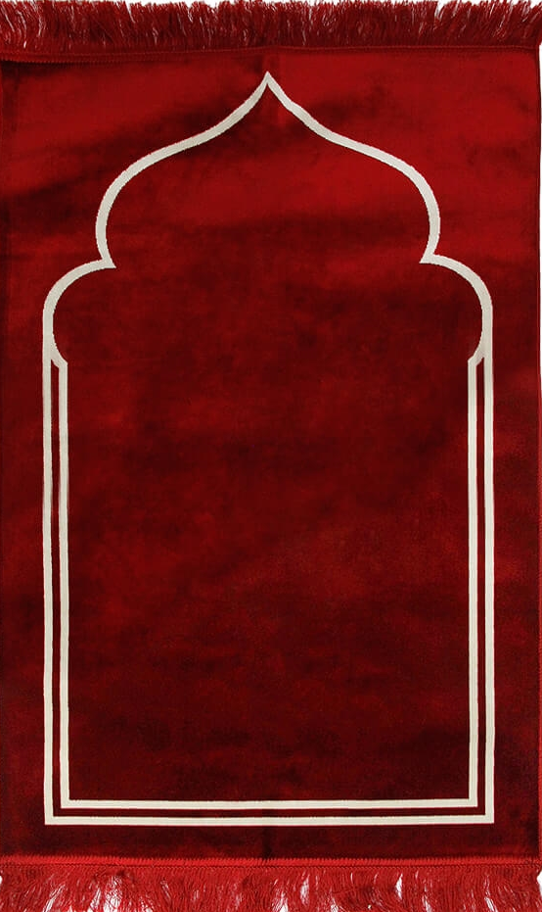
The Sense of Touch
The pattern, in gold lines upon a background of red, was plain: a narrow rectangle with a triangular peak at one extremity to indicate the qibla, the direction of prayer, and little curlicues floating around it, like wisps of smoke or accents from a strange language. The pile was soft. When I prayed, the short, unknotted tassels were inches from the tip of my forehead at one end of the carpet and inches from the tip of my toes at the other, a cozy size to make you feel at home anywhere upon this vast earth.
Muslim prayer rugs always have a side with a point on it called a mihrab. The mihrab is meant to point toward the qibla during prayer.

Slide 15
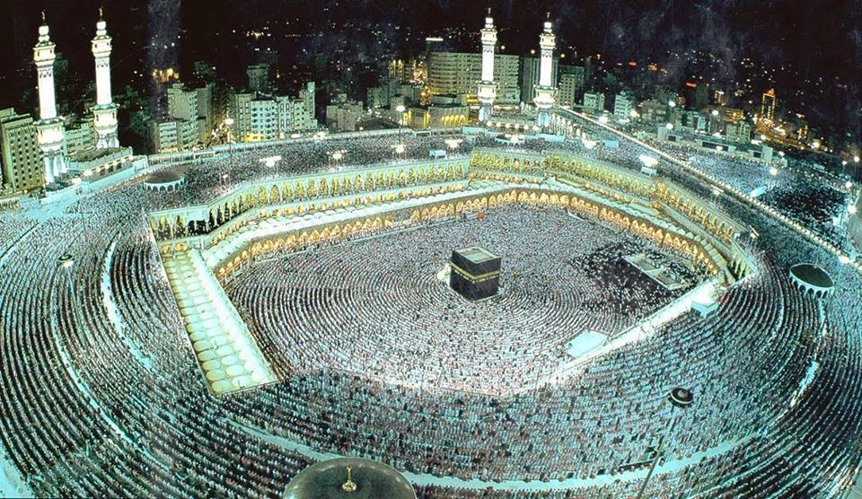
Islamic Prayer
While praying, muslims face towards the Kaaba, a cube shaped building in Mecca Saudi Arabia, the most holy site in the muslim religion. This provides them with a sense of unity, every muslim prays at the same times, and in the same direction every day.
In India Islam is the second most popular religion making up approximately 13.4% of the population. Around
138 188 240 people, and is the fastest growing religion.
Muslims have five specified times of day reserved for praying.
Fajr - Before sunrise
Dhuhr - Shortly after noon
Asr - Late in the afternoon
Maghrib - shortly after sunset
Isha - Late at night before going to bed.
Muslims pray 5 times a day because it is the second pillar of Islam. Allah ordered all muslims to pray five times a day in order to remind them that they are always connected to god, and to remind them of why they are here and the purpose in their lives.
Muslim prayers involve a series of crouching, bowing, kneeling, and standing followed by a series of prayers in Arabic. Every prayer session begins with saying “Allahu akbar” meaning god is great. The average praying session takes 5-10 minutes.

Slide 16
Cultural Significance
How Islamic Prayer Illuminates Indian Culture
Islamic prayer illuminates Indian culture by bringing to attention the variety of different faiths and traditions that are commonly practiced in India. Five times are set aside every day for muslims everywhere to stop and pray, and over 300 000 mosques have been built in india, more than anywhere else in the world despite India not being a primarily Islamic country.
How This Passage is Connected
The passage I chose from the Life of Pi connects to this source because Pi has just purchased an Islamic prayer rug, a type of rug specifically designed for muslim prayer. Pi was a practicing muslim, hindu, and christian, showing the level of diversity and religious acceptance in Indian culture. Pi’s family was not religious but while he explored and experience the culture growing up he came to love all three religions.
Significance in this Portfolio
This source was important to include in this portfolio because it shows the cultural significance and extensiveness of religion in Indian culture. Religion is taken very seriously in Indian culture and many aspects of daily life are influenced by it. Muslims must pray five times a day in order to follow the commands of Allah and even commercialized businesses selling religion oriented items such as prayer rugs are prevalent in India.

Slide 17
https://hopscotchtheglobe.com/why-indians-eat-with-their-hands/
http://www.bbc.co.uk/religion/religions/islam/practices/salat.shtml
https://www.icv.org.au/about/about-islam-overview/what-is-halal-a-guide-for-non-muslims/
https://medium.com/lifelong-benefits-of-a-plant-based-diet/vegetarianism-in-islam-5bb0a5dfe08f
http://www.mahavidya.ca/2010/08/19/vegetarianism-in-hinduism/
https://geog.ucsb.edu/the-geography-of-prayer/
http://religion.blogs.cnn.com/2011/03/21/why-do-muslims-pray-five-times-daily/
http://censusindia.gov.in/Census_And_You/religion.aspx
http://www.thedeenshow.com/halal-mustahabb-mubah-makrooh-haram/

Slide 18
https://www.thoughtco.com/animal-welfare-2004394
https://www.hinduwebsite.com/hinduism/essays/animals.asp
https://www.britannica.com/topic/prayer-rug
https://99namesofallah.name/
https://abdurrahman.org/2011/06/24/anyone-who-memorizes-the-names-of-allah-will-enter-jannah/
https://www.soundvision.com/article/dhikr-the-remembrance-of-allah
https://food.ndtv.com/food-drinks/ever-wondered-why-north-indian-food-is-so-spicy-heres-the-answer-1905675
http://www.irna.ir/en/News/81699685

